Slide 1
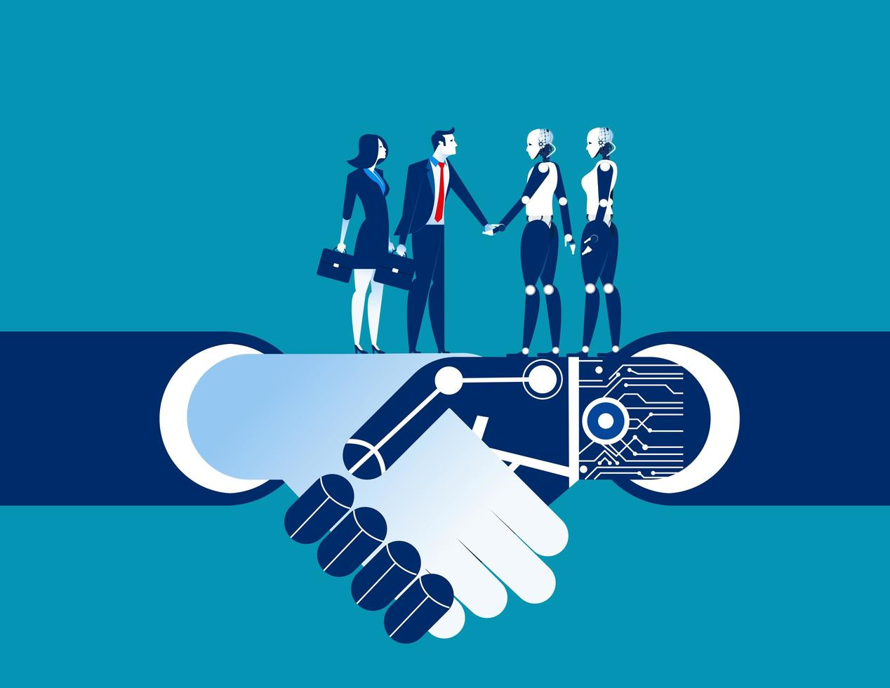
Personalized Large Language Models
A New Horizon for Human-AI Interaction
By - Rutuja Bhaskarrao Patil

Slide 2
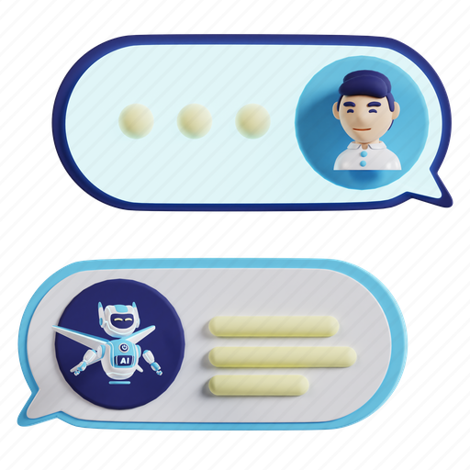
Introduction
Overview:
Large Language Models (LLMs) like ChatGPT and DeepSeek are powerful general-purpose tools.
However, they often lack personalization, falling short in understanding individual user behaviors.
Personalized Large Language Models (PLLMs) aim to bridge this gap by tailoring interactions to individual users.

Slide 3

What Are PLLMs?
Definition:
PLLMs utilize personal data such as user profiles, past conversations, preferences, and queries to generate individualized responses.
Applications:
Recommendation systems
Medical assistants
Conversational agents
Personalized learning tools

Slide 4
Three Pillars of Personalization Personalization in PLLMs is structured into three levels:
Personalized Prompting – Input Level
Personalized Adaptation – Model Level
Personalized Alignment – Objective Level

Slide 5
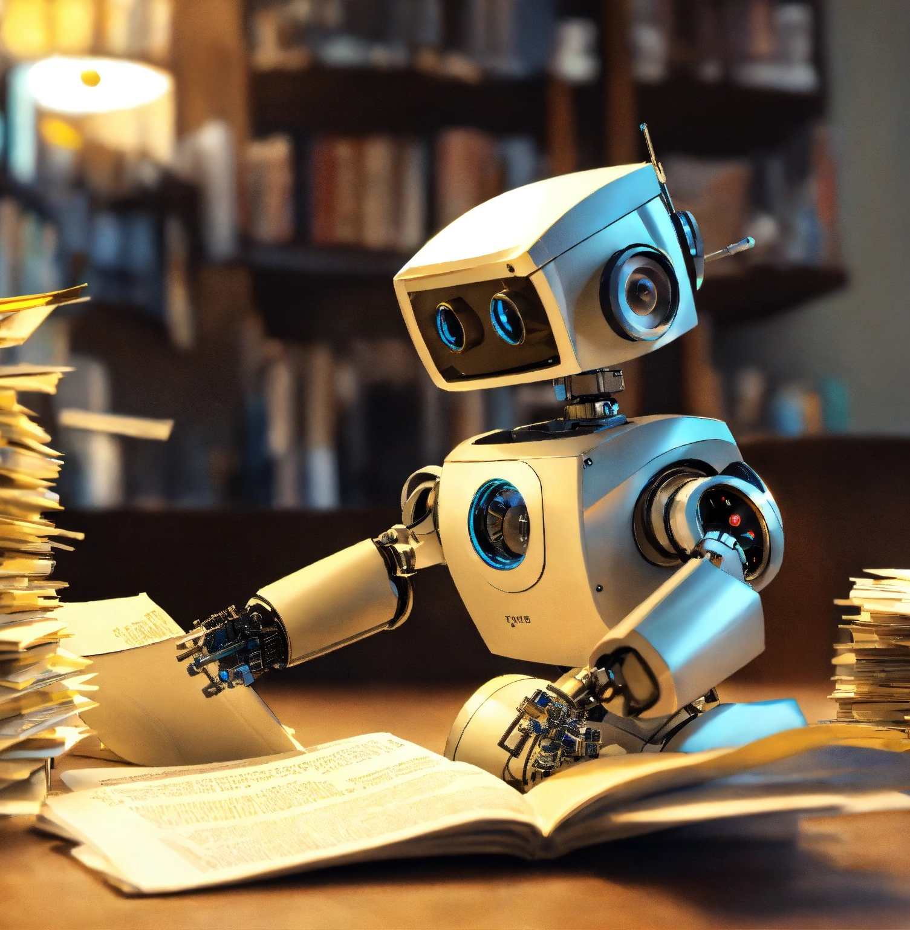
Personalized Prompting (Input Level)
Techniques:
Profile-Augmented Prompting: Incorporates static user information like name and occupation.
Dialogue History Prompting: Utilizes previous conversations to create context-aware prompts.
Retrieval-Augmented Prompting: Enhances prompts by retrieving relevant historical data from a memory bank.
Use Case:
A medical chatbot that recalls your medical history to ask intelligent follow-up questions.

Slide 6
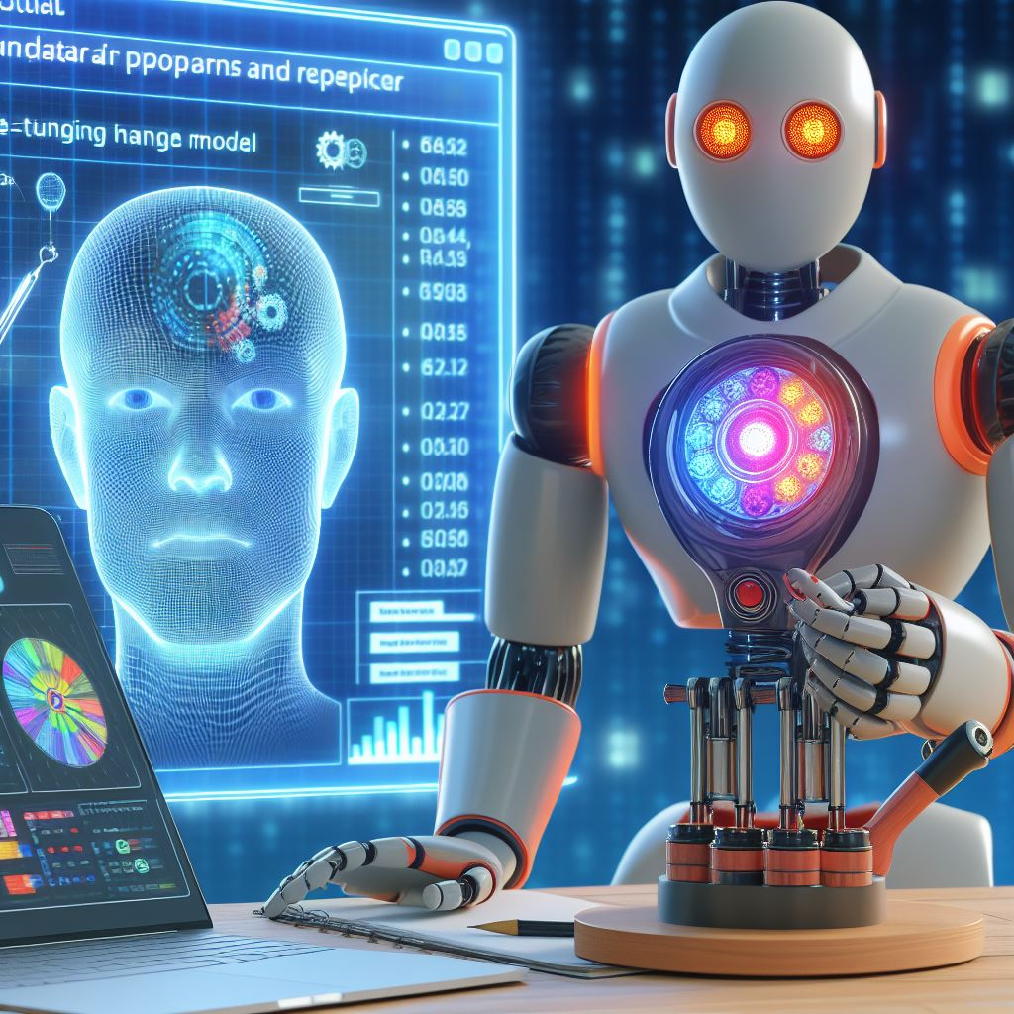
Personalized Adaptation (Model Level)
Techniques:
Parameter-Efficient Tuning (e.g., LoRA): Makes minor adjustments to the model without full retraining.
Fine-Tuning with Personal Data: Deep customization for applications like educational tutors.
Memory Modules: External modules that store and provide personal context dynamically.
Use Case:
A coding assistant that learns your coding style and preferred libraries over time.

Slide 7
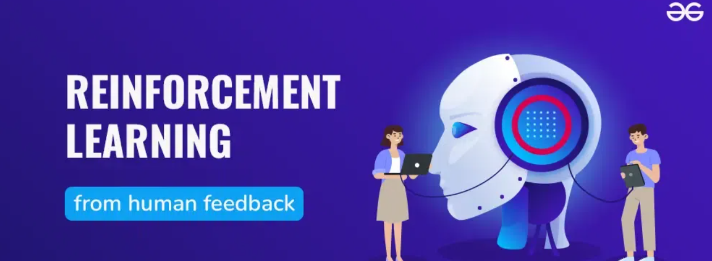
Personalized Alignment (Objective Level)
Techniques:
Reinforcement Learning with Human Feedback (RLHF): Refines model responses based on user feedback.
Direct Preference Optimization (DPO): Trains the model using explicit rankings of preferred outputs.
Meta-Learning: Enables the model to quickly adapt to new users by learning how to learn.
Use Case:
A writing assistant that gradually adapts to match your tone and word choice based on your edits.

Slide 8
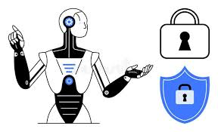
Challenges in PLLMs
Key Challenges:
Privacy and Security: Safely storing and using personal data.
Scalability: Efficiently personalizing models for millions of users.
Evaluation: Measuring the effectiveness of personalization.
Long-Term Memory Management: Managing and retrieving user interactions over time.
Adaptability: Ensuring models can adapt to changing user behaviors and preferences.

Slide 9
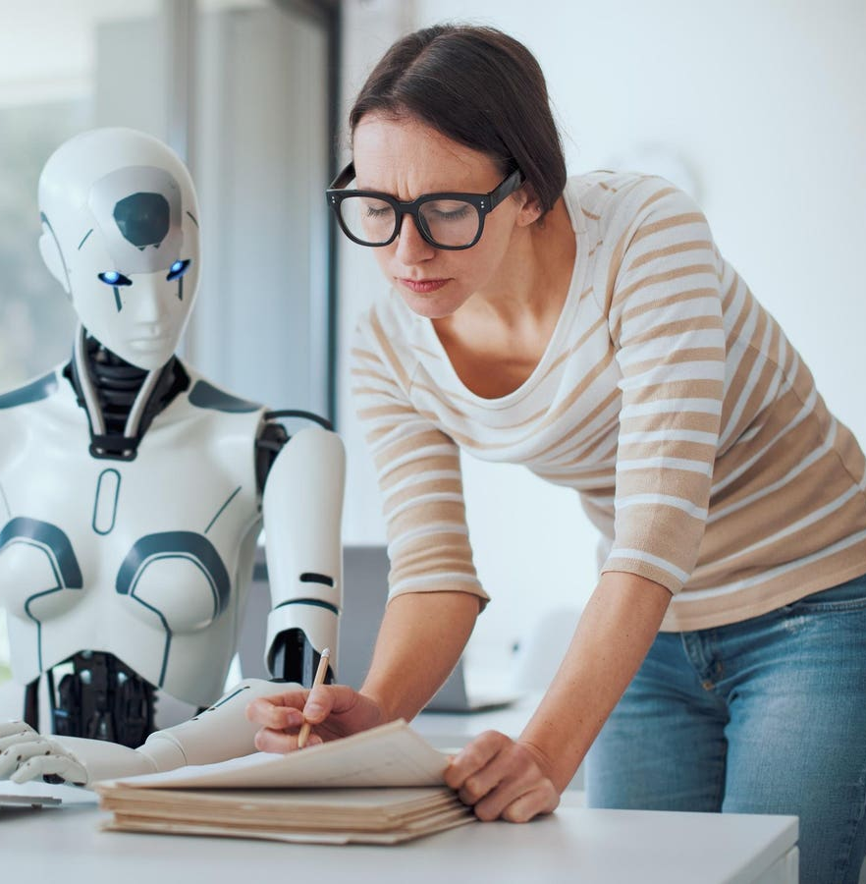
Future Directions
Emerging Trends:
Multimodal Personalization: Combining voice, text, video, and emotion signals.
Edge Deployment: Running personalized models on local devices to enhance privacy.
Federated Learning: Training models across devices without centralizing personal data.

Slide 10
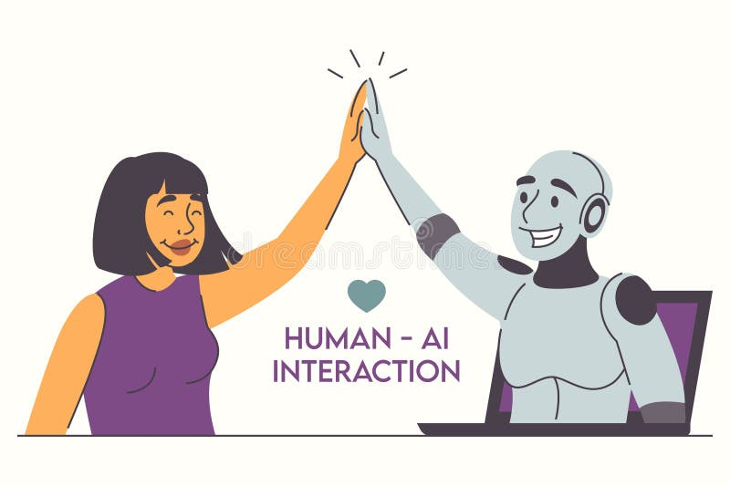
Conclusion
Summary:
Personalized LLMs represent a significant step toward more intuitive and user-centric AI systems.
By tailoring interactions based on individual user data, PLLMs can transform various applications, making AI more responsive and aligned with human needs.
As the field evolves, we can expect AI systems that know us, learn from us, and adapt to us.

Slide 11
References
Primary Source:
Medium Article by Rutuja Bhaskarrao Patil
Additional Reading:
A Survey of Personalized Large Language Models: Progress and Future Directions

